Slide 1
SPIRITUAL PLACES IN ITALY

Slide 2
INtroduction
Let’s say you have never been in Italy and you want to visit only basilicas while you are there. So you want to go to a city with a high density of basilicas around you. The problem we aim to solve is to analyze the basilicas' locations in the most beautiful north-center Italy Cities, such as Rome, Milan and Florence in order to find the best place for our pilgrimage.

Slide 3
DATA
I will use the FourSquare API to collect data about locations of Basilicas in Rome, Milan and Florence. These are one of the most beautiful Italy cities.

Slide 4
Methodology
My main target here is to asses which city would have the highest spiritual places density. I used the Four Square API through the venues channel. I used the near query to get venues in the cities. Also, I use the CategoryID to set it to show only Spiritual Places. An Example of my requests:
  https://api.foursquare.com/v2/venues/explore?&client_id=&client_secret=&v=20180605&Roma, RM&limit=100&categoryId=4bf58dd8d48988d131941735
  Next, to get an indicator of the density of Spiritual Places, I calculated a center coordinate of the venues to get the mean longitude and latitude values. Then I calculated the mean of the Euclidean distance from each venue to the mean coordinates. That was my indicator; mean distance to the mean coordinate.

Slide 5
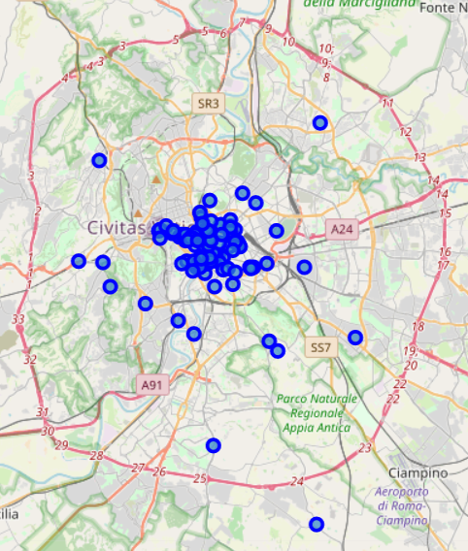
Result (rome)

Slide 6
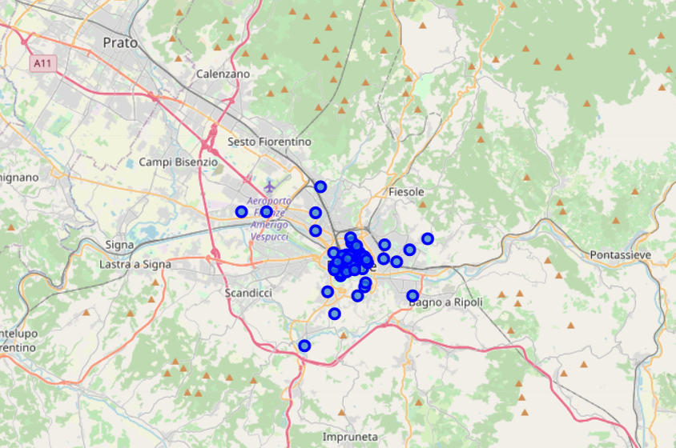
Result (firenze)

Slide 7
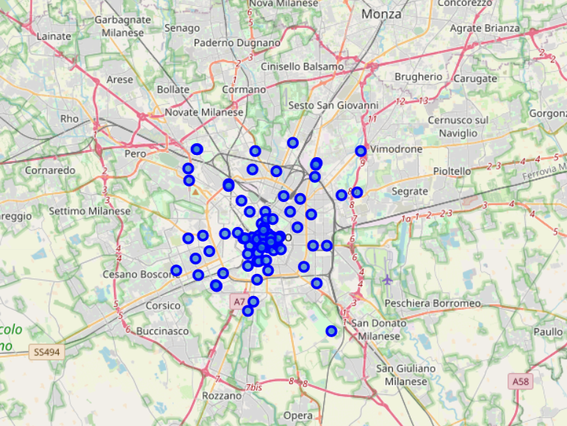
Result (milano)

Slide 8
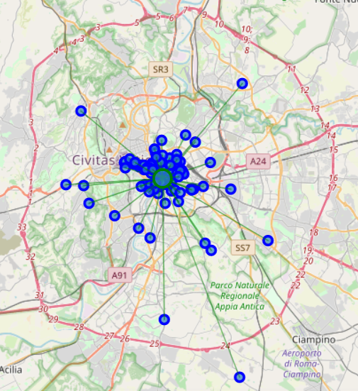
Result with mdmc (rome)

Slide 9
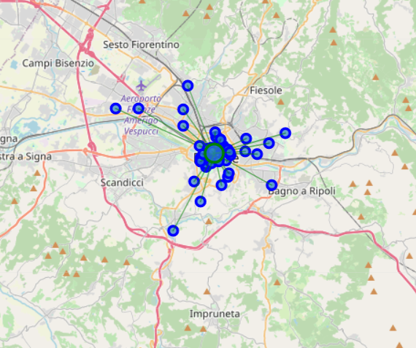
Result with mdmc (firenze)

Slide 10
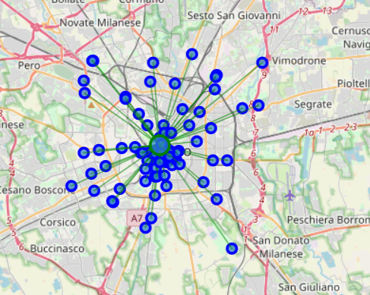
Result with mdmc (milano)

Slide 11
discussion
One thing I noticed in the figure is that in Rome we have a lot of outliers because Rome is a lot bigger than Firenze so this is probably giving it a higher MDMC. Moreover, we have only 68 points for Firenze. So I checked what if I take into account only the first 68 places for Rome too
The new MDMC was: 0.01014990, putting Rome at the first place.

Slide 12
Conclusion
Now there is no doubt that Roma is the best place to visit many Spiritual Places. Also, if our tourist is done with all the Roma spiritual places he can go to Firenze in just 2-3 hours and enjoy more spiritual places.

